Slide 1

About akinator
FREE PPT TEMPLATE BY DELIGHT.
Gun-hee Kwon hyung-suk Song

Slide 2
What is akinator?
An Akinator is a program engine that guesses and matches real or imaginary characters based on the answers to questions, a kind of artificial intelligence that uses databases. There is a web version and mobile version.
https://en.akinator.com/

Slide 3
Great Akinator!
If Akinator ask questions that seem to have nothing to do with it, and then suddenly ask questions that are close to the answer, you might even feel that you are using mind-reading.
It is difficult for world-famous celebrities to fill 10 questions, and also fiction characters.
Moreover, It also answers about rides, weaponry, food, Internet buzzwords, household items, and even problem books!

Slide 4
Why do we choose an akinator?
Because akinator is based on database, it is a kind of artificial intelligence that guesses what users think through 20 questions.
So, we will take a look at setting datasets, and using a data base to product results.

Slide 5
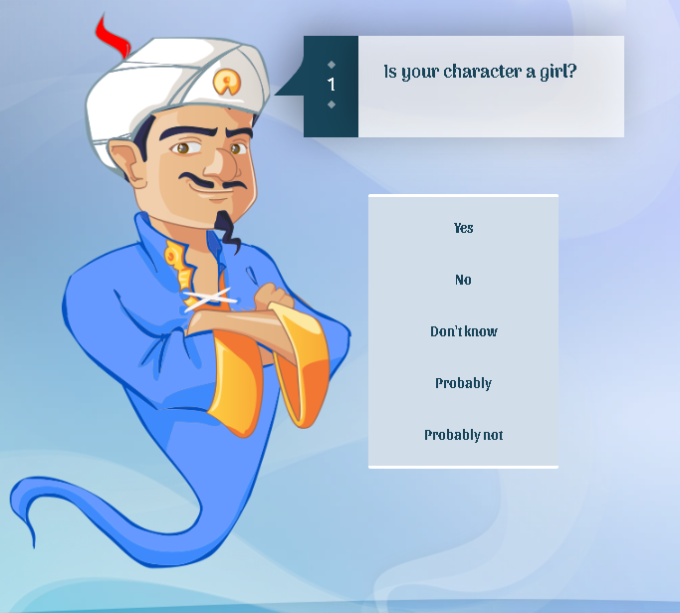
Guess akinator
Example of an Aquiner's question
We can see from here that when the Akinator’s answers, it prepares five answers and weights them accordingly.
And the question is, what is in the database is a sort of question.

Slide 6

Guess akinator
It may separate databases on each criteria, and it weighs on the answers and identifies the tendency of those who have responded to them to think about who as a result is.
start
Man
youtuber
…
Woman
…
…
Man
Cook
Baek Jong Won
etc,…
Man
Game Youtuber
Sal Gu
etc,…

Slide 7
Guess akinator
And when people choose a boy who exists in a movie, if the most important person is Harry Potter, and it shows a question that it can guess the answer as Harry Potter, like “Does he have a lightning scar on his forehead?”

Slide 8
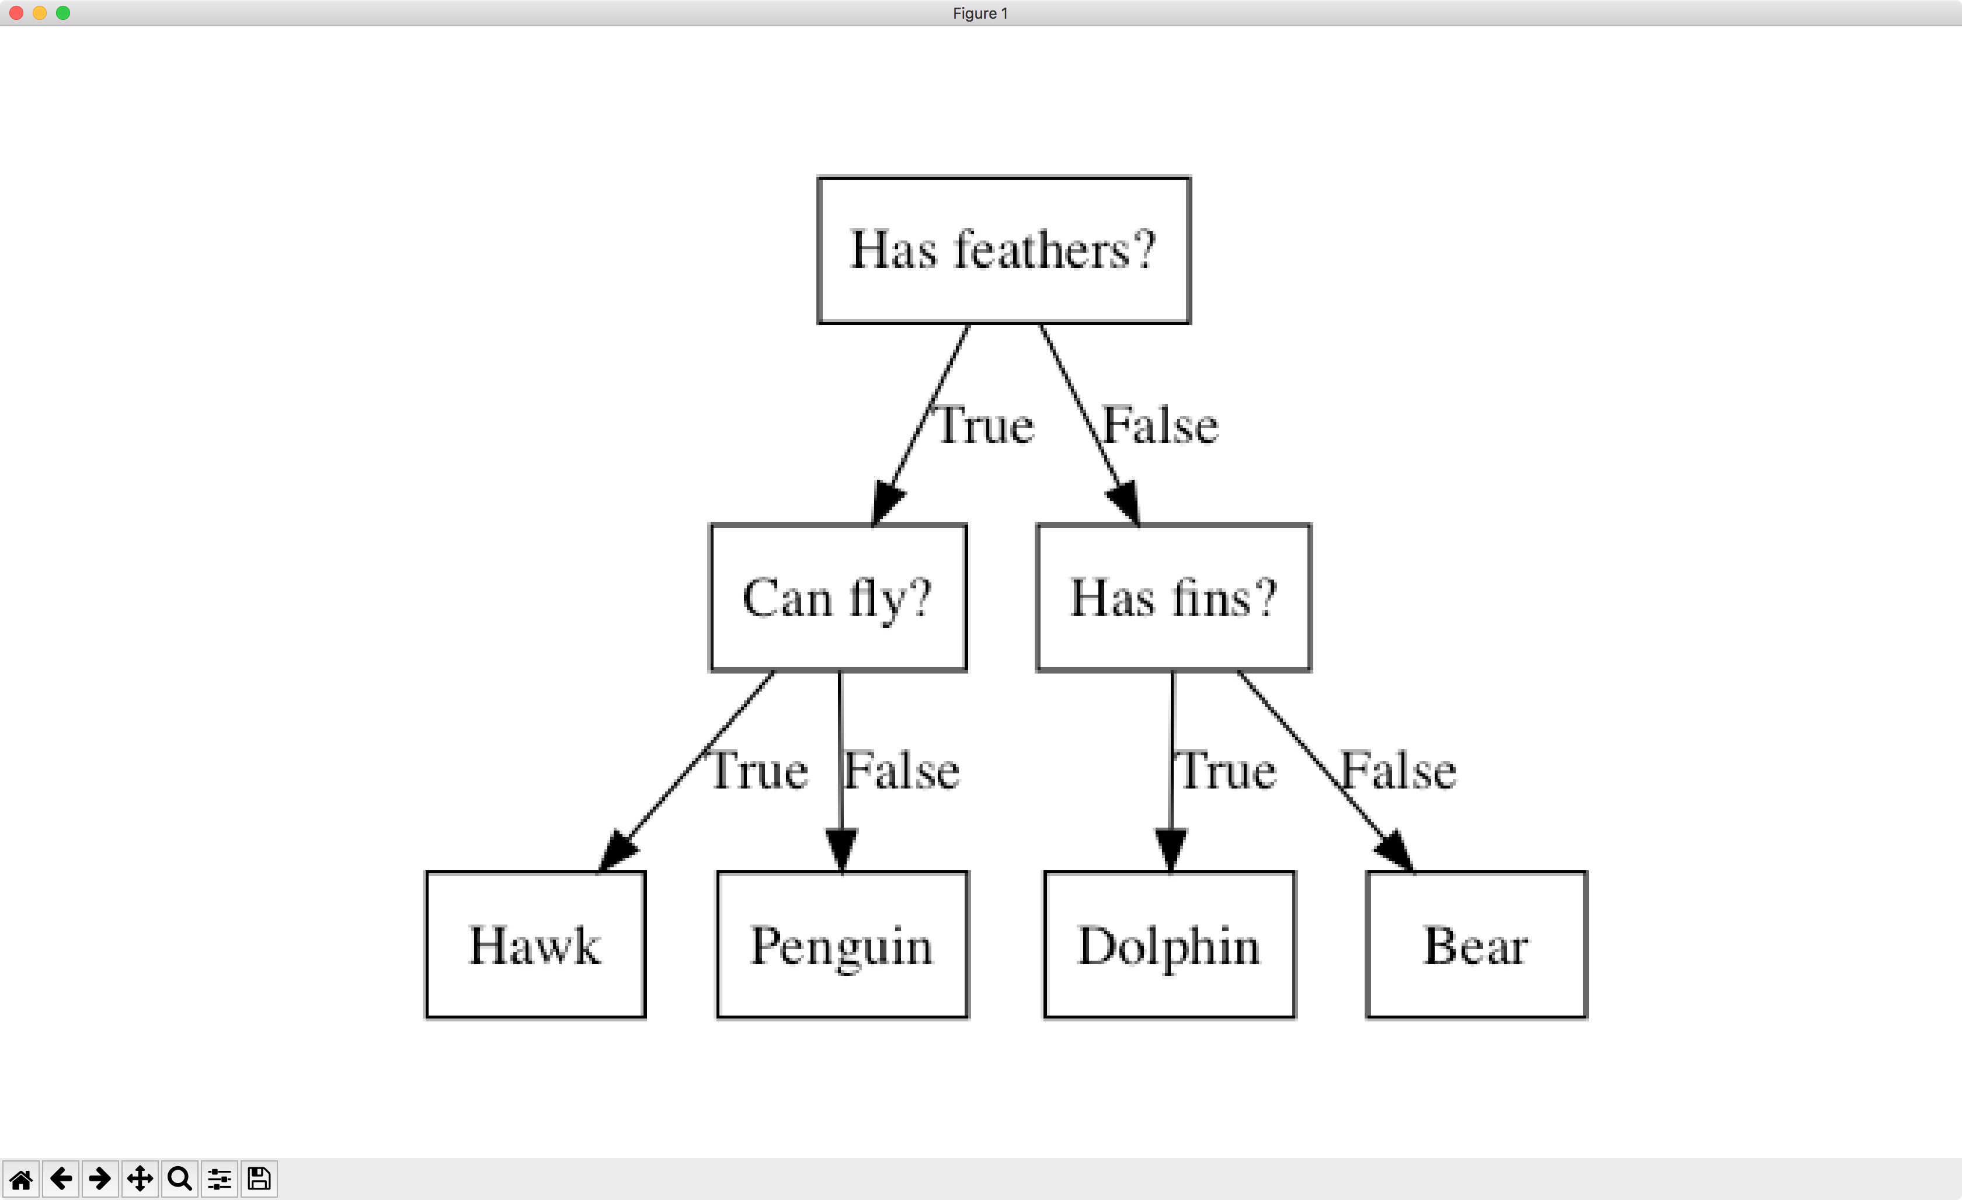
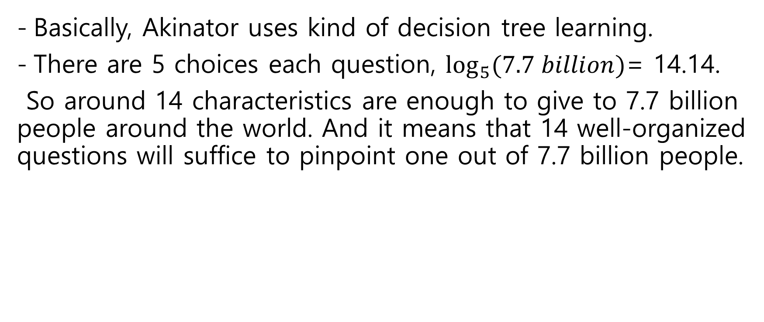
Principle
Basically, Akinator uses kind of decision tree learning.
There are 5 choices each question, $\log_{5}{(7.7 billion)‬}$= 14.14.
So around 14 characteristics are enough to give to 7.7 billion people around the world. And it means that 14 well-organized questions will suffice to pinpoint one out of 7.7 billion people.

Slide 9
How Akinator mines data
By users
If you feel there are not enough questions to paraphrase the character or if you find a question that Jinny is expecting the wrong answer, you can add or correct the question. You can also modify the name or description of a character after approved by the administrator

Slide 10
How Akinator mines data
2. By questions
While playing the game, there are times when Akinator does two to three questions which is far from answer before answering, even if Akinator almost get an answer.
This is to collect data by asking questions about a lacking information of character which Akinator has confidence.

Slide 11
Possible problems
Malicious users can answer randomly and say ‘yes’ to akinator’s answer.
Akinator asks for the most recent or frequent words. Therefore, old or minor things can be difficult to find.

Slide 12
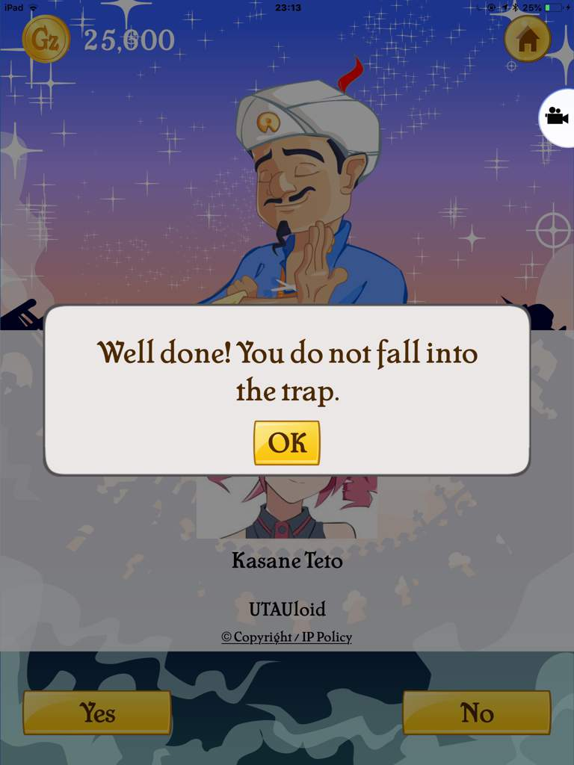
Solution of problems
Sometimes, the Akinator comes up with traps.
If Akinator judges user as a yes-man or no-man
or malicious user who is answering just randomly,
It gives trap answer which has different feature
user answered. If user says ‘yes’ to it, Akinator
ignores that data.

Slide 13
Solution of problems
2. Aki-award
In mobile version, if Genie answered a correct answer, user gets Aki-award, which is a ranking score.
The Aki Awards depend on how old the most recent date that the character was played by another user.
More than 12h → +1 More than 1month → +64
More than 48h → +4 More than 6month → +356
More than 1week → +16

